Slide 1
CASE STUDY • CVM TEAM
BrightTV
Viewership Analytics & Growth Strategy
Insights, drivers of consumption, and recommendations
to grow the subscription base this financial year.
Prepared for the CEO | Source: BrightTV User Profile × Viewership dataset

Slide 2
OVERVIEW
Agenda
01
Dataset Overview
Scope, KPIs and headline numbers
02
User & Usage Trends
Who is watching, when and where
03
Factors Influencing Consumption
Demographics, geography & timing
04
Low-Consumption Days — Content Plan
What to schedule on Mon / Tue / Sun
05
Growth Initiatives for the User Base
CVM-led recommendations
BrightTV | Viewership Analytics
CVM Insights

Slide 3
01 DATASET OVERVIEW
Dataset Overview — Headline Numbers
TOTAL SESSIONS
UNIQUE USERS
AVG SESSION (MIN)
PEAK HOUR (SAST)
10,000
4,386
9.1
17:00
Top channel
Supersport Live Events
Top province
Gauteng
Note: All session times converted from UTC to South African Standard Time (UTC+2).
Each row in the dataset = one viewing session.
BrightTV | Viewership Analytics
CVM Insights

Slide 4
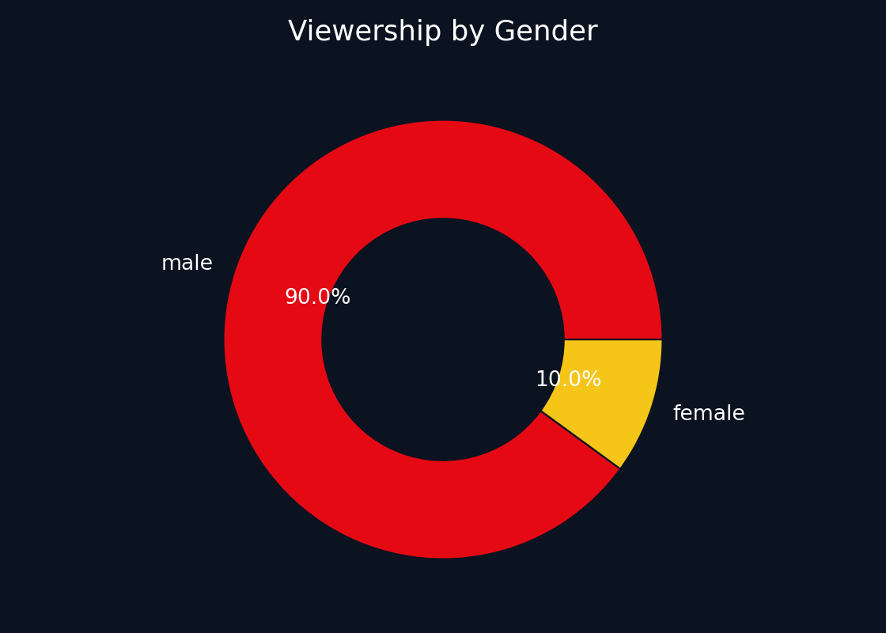
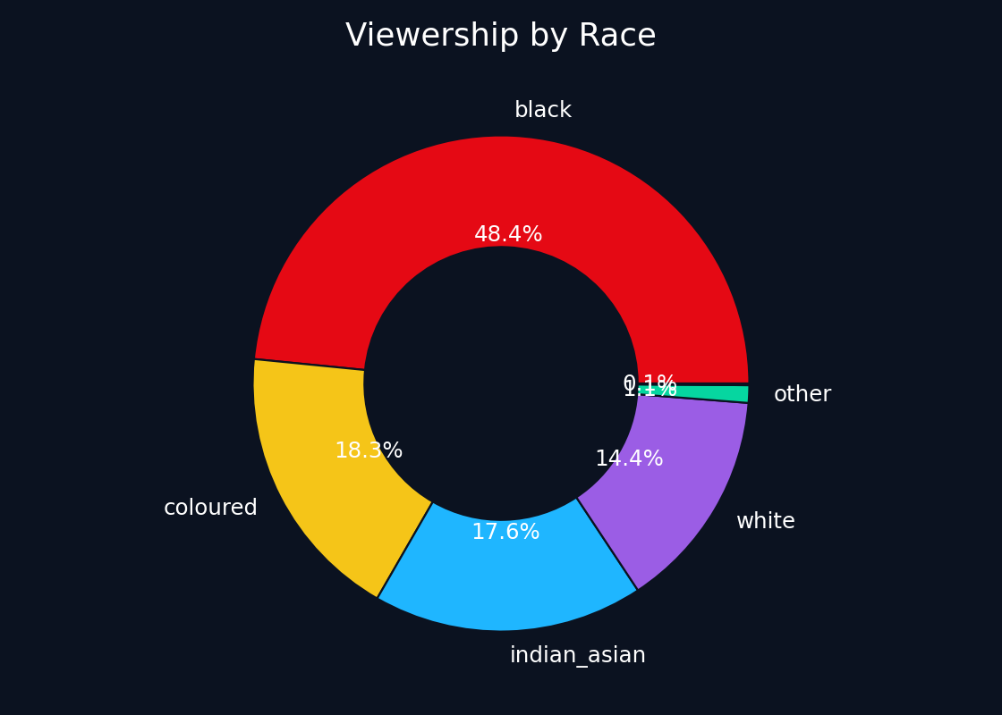
02 USER & USAGE TRENDS
Who Is Watching — Gender & Race Mix
Audience skews MALE; black viewers are the single largest race segment, followed by white and Indian/Asian — segments to anchor any CVM campaign.
BrightTV | Viewership Analytics
CVM Insights

Slide 5
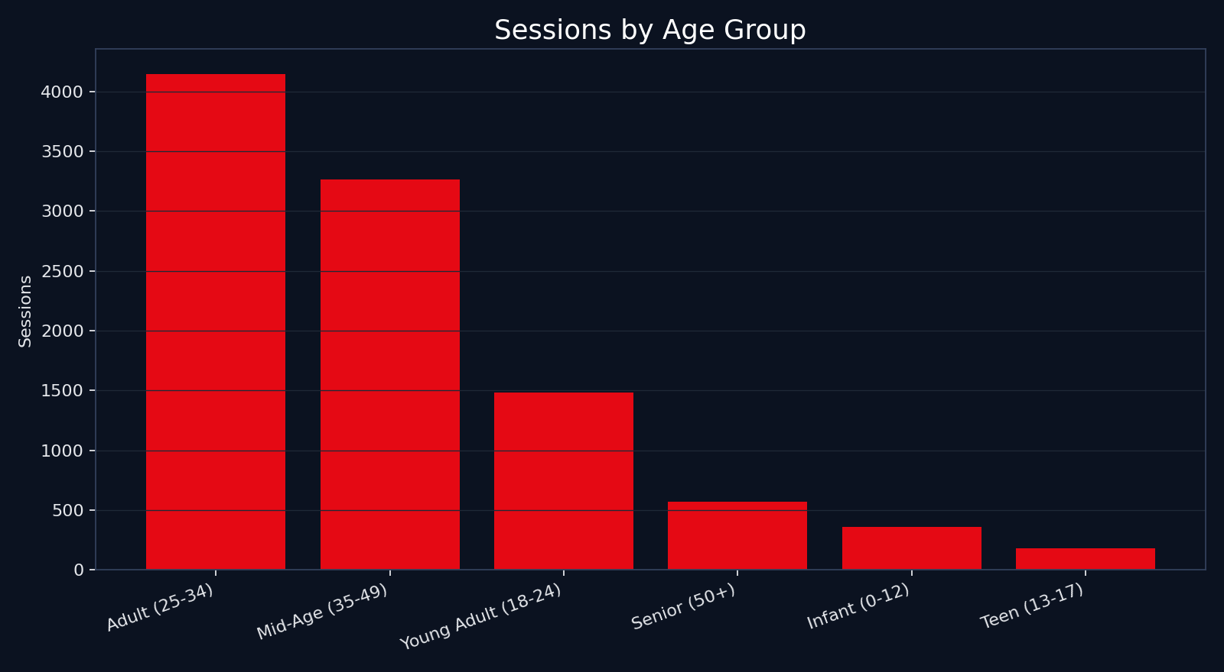
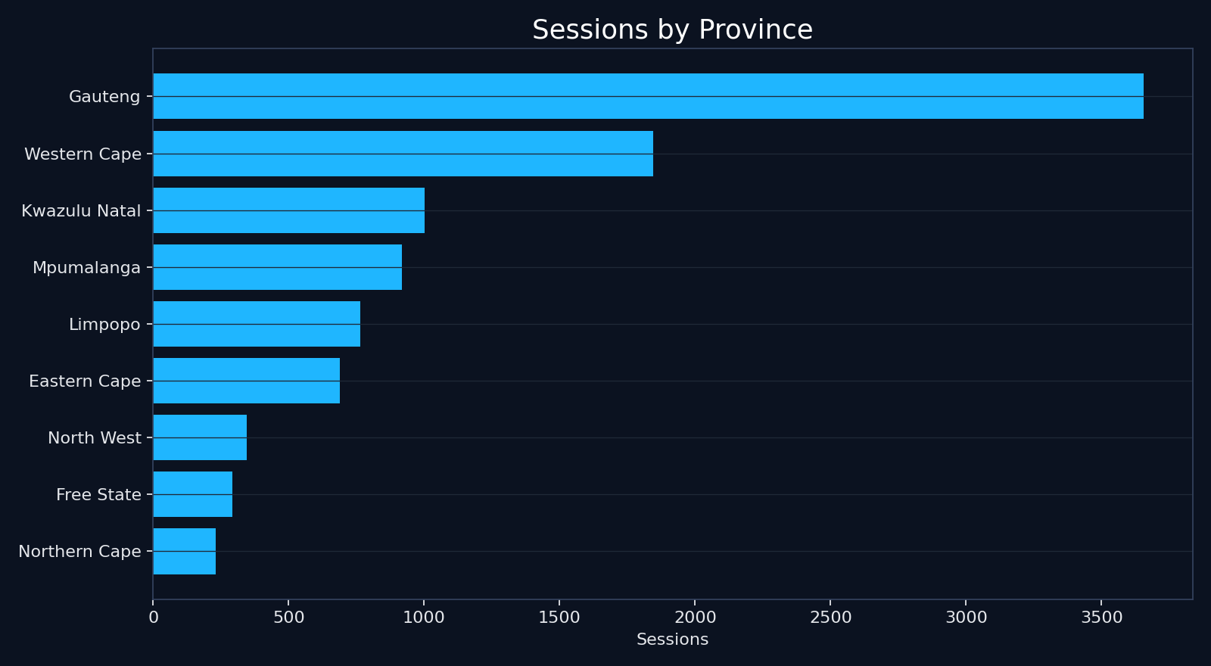
02 USER & USAGE TRENDS
Age Groups & Provincial Footprint
Adults 25–34 dominate consumption; Gauteng leads provinces. Lower-volume provinces (NW, NC, FS) are clear acquisition white-space.
BrightTV | Viewership Analytics
CVM Insights

Slide 6
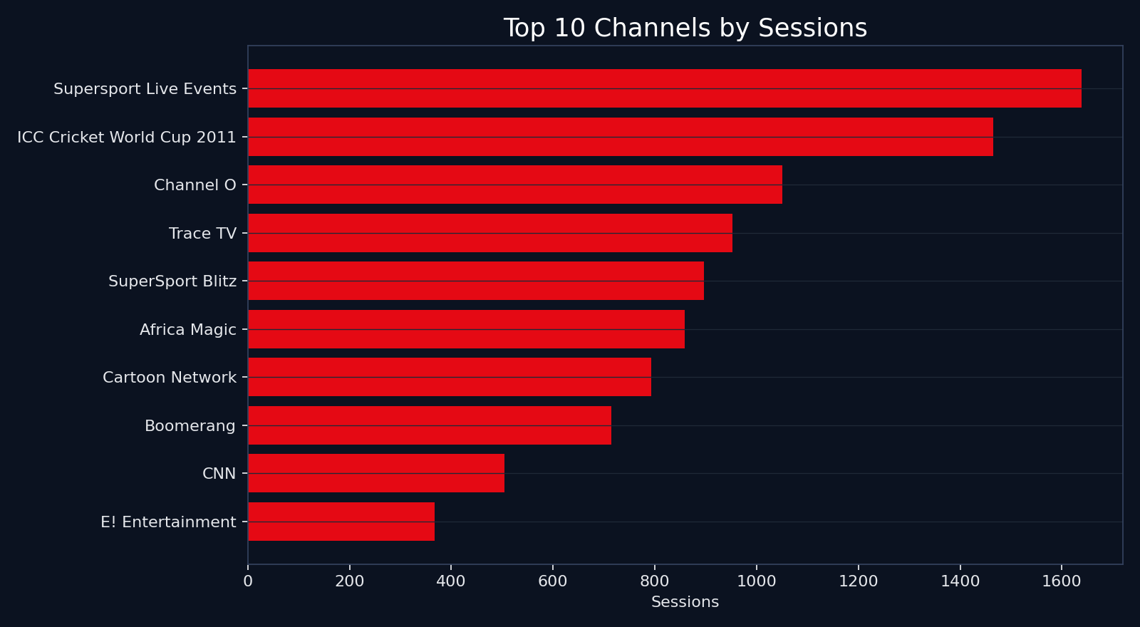
02 USER & USAGE TRENDS
Top 10 Channels by Sessions
KEY TAKEAWAYS
• Sport drives the top of the chart — SuperSport & ICC Cricket are the #1 and #2 channels.
• Music (Channel O, Trace TV) and youth content follow closely.
• Long-tail kids/movie channels under-index relative to audience size.
BrightTV | Viewership Analytics
CVM Insights

Slide 7
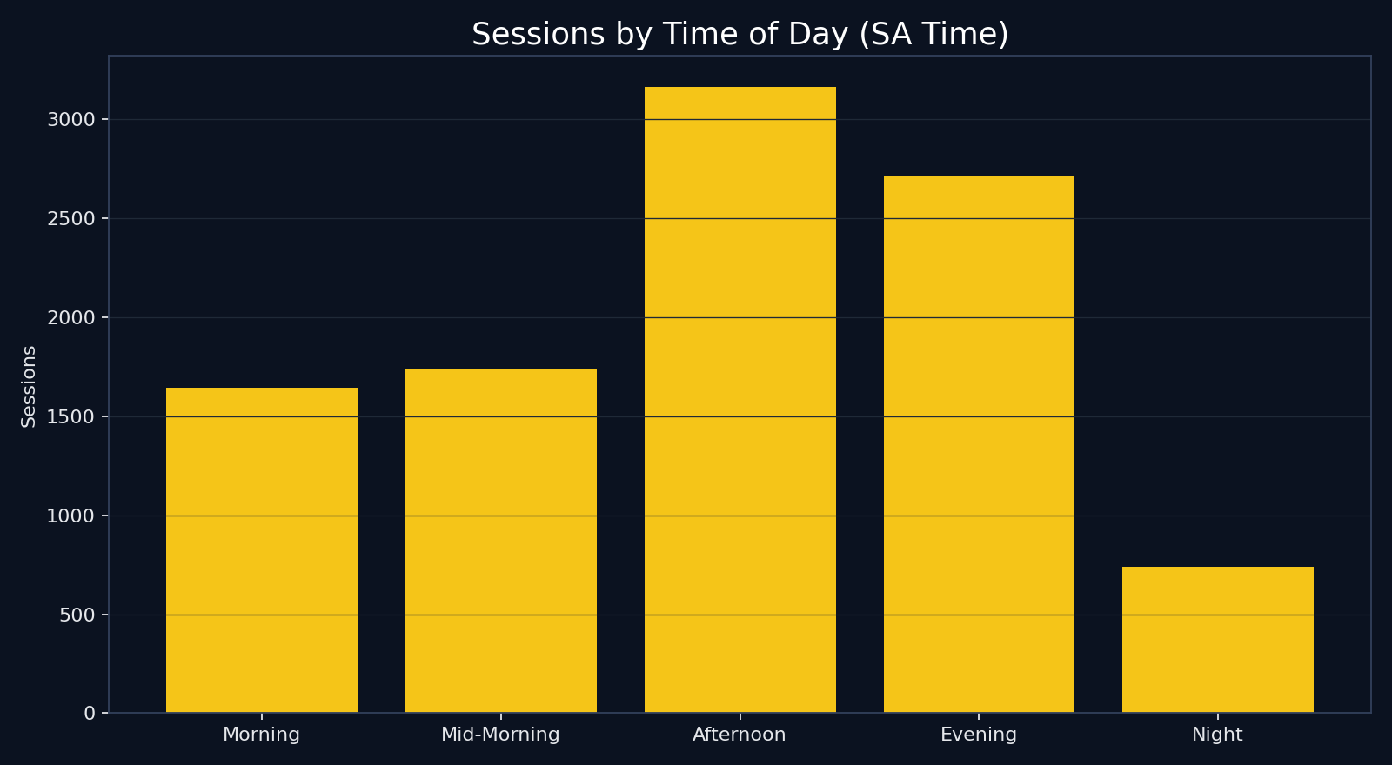
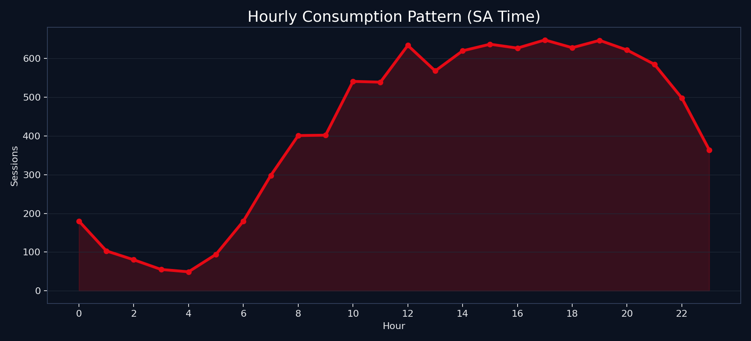
02 USER & USAGE TRENDS
When BrightTV Is Watched (SA Time)
Peak window is the Evening / Night band, peaking at 17:00 SAST. Mid-mornings and late nights are the softest dayparts.
BrightTV | Viewership Analytics
CVM Insights

Slide 8
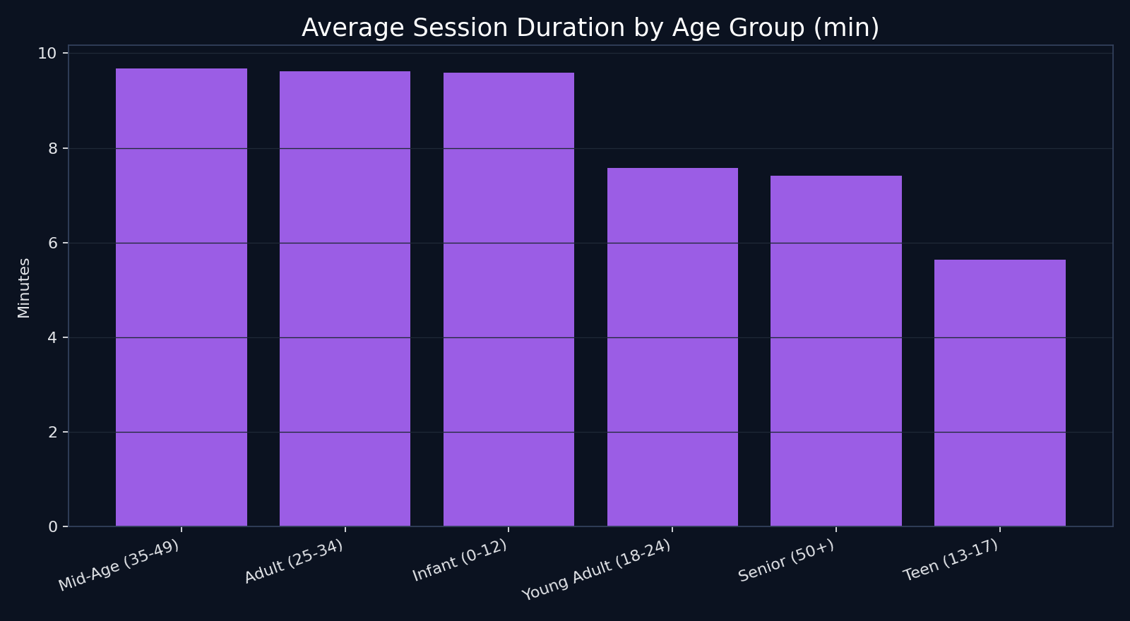
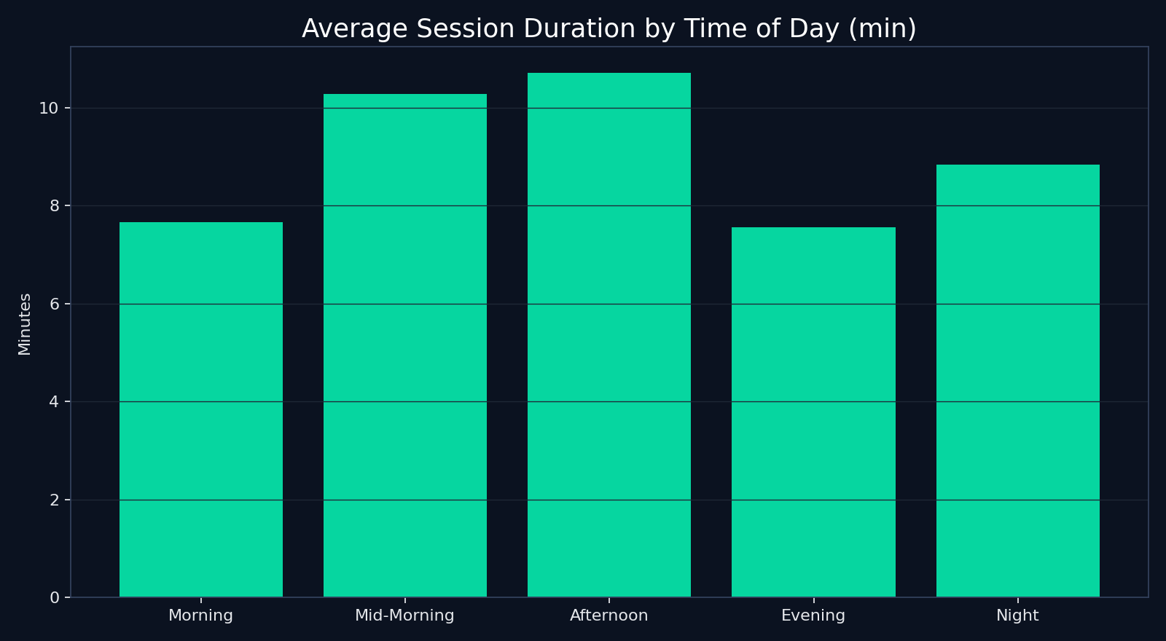
03 FACTORS INFLUENCING CONSUMPTION
What Drives Consumption?
Demographics (age & gender), geography (province), daypart (evening/night) and content genre (sport, music) are the dominant levers. Average session length rises sharply in evening windows — confirming a prime-time effect.
BrightTV | Viewership Analytics
CVM Insights

Slide 9
03 FACTORS INFLUENCING CONSUMPTION
Factor Impact — At a Glance
Factor | Observation | Impact
Age | Adults 25–34 dominate; Seniors 50+ smallest | HIGH
Gender | Skew to male viewers | MED
Province | Gauteng & WC concentrate >50% of sessions | HIGH
Daypart | Evening / Night peak at 17:00 | HIGH
Day of week | Friday peak; Mon/Tue/Sun softest | MED
Content genre | Sport & music outperform; kids under-index | HIGH
BrightTV | Viewership Analytics
CVM Insights

Slide 10
03 FACTORS INFLUENCING CONSUMPTION
The Age–Content Matrix: Demographics Define Channel Preference
Top Channels
Boomerang /
Cartoon Net.
Trace /
Channel O
SuperSport /
Cricket
Africa Magic
Influencing Factors
Infant (0–12)
Age is the absolute primary factor influencing channel preference.
The platform serves highly distinct, siloed audiences rather than a single monolithic viewer.
Content packaging must respect these rigid demographic boundaries.
Teen (13–17)
Young Adult (18–24)
Adult (25–34)
Mid-Age (35–49)
Senior (50+)
BrightTV | Viewership Analytics
CVM Insights

Slide 11
03 FACTORS INFLUENCING CONSUMPTION
Engagement Depth: Session Volume vs. Session Duration
THE SNACKERS
THE BINGERS
Trace TV, Channel O, SuperSport Blitz
ICC Cricket World Cup, SuperSport Live
Frequent but brief sessions. Highly habitual, rapid information or background utility.
Deep, extended engagement. The anchor content that justifies the subscription cost.
S
E
S
S
I
O
N
S
THE ROUTINE
THE APPOINTMENTS
Boomerang, Cartoon Network
Africa Magic, M-Net
Shorter, targeted viewing sessions, highly concentrated in specific demographic day-parts.
Deliberate, scheduled viewing of long-form narrative content.
Session Duration (Time) →
High session counts do not equal long watch times. Growth tactics must differentiate between promoting "snackable" utility channels and "appointment" premium networks.
BrightTV | Viewership Analytics
CVM Insights

Slide 12
03 FACTORS INFLUENCING CONSUMPTION
Time & Content Synergy: The Shifting Platform Identity
Daytime Viewing
Nighttime Viewing
(Morning & Mid-Morning) • ~09:00
(Evening & Night) • ~20:00
Dominant Content:
Dominant Content:
Kids Animation (Boomerang) & Sports Replays.
Long-form narrative (Africa Magic), Live Events, Reality (E!).
Active User:
Active User:
Secondary household members (children, non-traditional working hours).
Primary account holders winding down post-workday.
Viewing State:
Viewing State:
Passive, routine viewing.
Active, appointment viewing.
Time of day dictates the "active user" within the household. The consumption model shifts completely from secondary viewers in the morning to primary bill-payers in the evening.
BrightTV | Viewership Analytics
CVM Insights

Slide 13
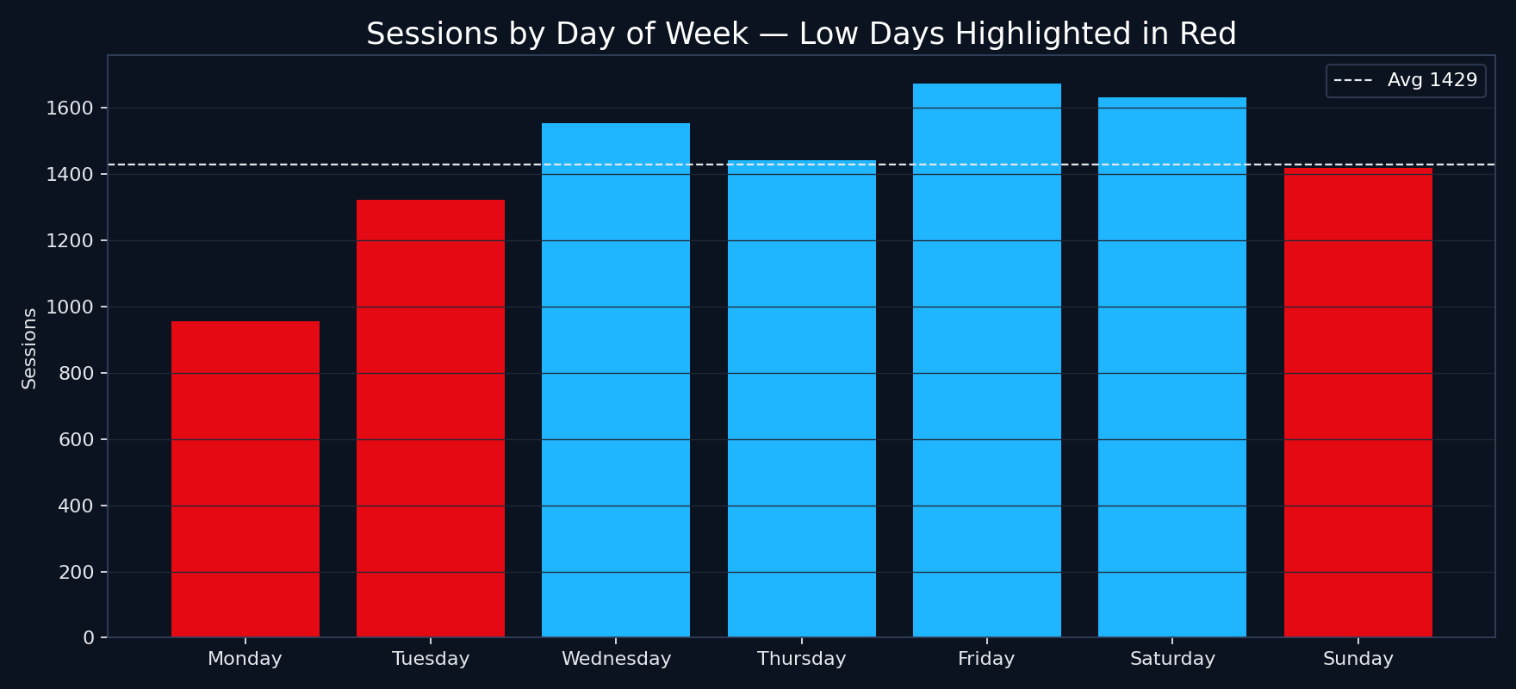
04 LOW-CONSUMPTION DAYS
Low-Consumption Days: Mon, Tue & Sun
OBSERVATION
Friday is the strongest day; Monday, Tuesday and Sunday fall below the weekly average.
Opportunity: programme high-pull, exclusive content into these dayparts to flatten the consumption curve.
BrightTV | Viewership Analytics
CVM Insights

Slide 14
04 CONTENT RECOMMENDATIONS
Content Plan to Lift Low-Consumption Days
MONDAY
Premiere night
Drop new series episodes & blockbuster movie premieres at 19:00 — capitalise on the prime-time peak.
TUESDAY
Live sport & docuseries
Mid-week live football / cricket highlights packages and binge-worthy true-crime docuseries for 25–34 segment.
SUNDAY
Family & lifestyle
Family movie afternoon, reality TV finales and music chart shows (Channel O / Trace TV) targeting weekend wind-down.
BrightTV | Viewership Analytics
CVM Insights

Slide 15
05 GROWTH RECOMMENDATIONS
Initiatives to Grow the User Base
Targeted Acquisition
Segmented Pricing
Run digital campaigns in under-indexed provinces (NW, NC, FS, Limpopo). Bundle with local mobile data partners.
Student & family bundles aimed at the 13–24 group; senior-friendly bundles at lower price points.
Sport-led Hooks
Personalised CVM Journeys
Use SuperSport / Cricket as anchor content for free-trial offers — converts highest-intent viewers.
Trigger emails / WhatsApp nudges by age × genre; recommend channels based on session history.
Reduce Churn on Light Days
Loyalty & Referral
Push Mon/Tue/Sun content drops via app notifications to keep dormant users engaged.
Reward long-tenure users with previews & referral discounts to drive organic acquisition.
BrightTV | Viewership Analytics
CVM Insights

Slide 16
SUMMARY
Grow BrightTV by doubling down
on what already works.
• Anchor on Adults 25–34, Gauteng & WC, evening prime-time, sport & music.
• Programme premieres and live sport into Mon / Tue / Sun to lift low days.
• Use CVM segmentation, targeted acquisition in low-share provinces, and loyalty tools to grow subscribers.

